Slide 1
‘Life after Levels’ Assessment Information Session for Parents
October 2015
Harrison Primary School

Slide 2
Aims for the session…
Share the national context for changes to assessment.
Give an introduction the new assessment framework in line with the new curriculum
Help parents understand how their children are assessed in school and why.
Help parents understand what the results mean for their child.
Share some of the key curriculum changes in Literacy and Mathematics in the new National Curriculum.

Slide 3
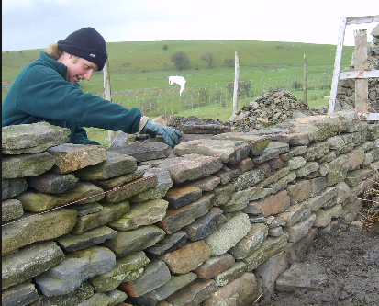
Context and background
New National Curriculum – implemented in September 2014 for Year 1, 3, 4 and 5. Year 2 & 6 retained the old curriculum until July 2015
Increased challenge
From September 2015, National Curriculum level descriptors no longer in use as they do not relate to the new National Curriculum expectations.
Expectation that all pupils will be working at
age related expectations for their year group for
reading, writing and maths.
Now ‘Keep up’ not ‘Catch up.’

Slide 4
How does this affect children that need extra support or extra challenge?
Provide a range of opportunities
Provide a range of resources
Teach through a different context or stimulus
Give children the opportunity to apply their skills and knowledge in a range of different ways and contexts

Slide 5
Types of assessment
Diagnostic
Observational
Formative (Day to day assessment, Learning intention and success criteria, Pupil Learning Review Meetings)
Summative (KS1 SATs/KS2 SATs, Annual reports to parents)

Slide 6
Old Curriculum Expectations for assessment
End of KS1 (Y2) – L2b
End of KS2 (Y6) – L4

Slide 7
New Curriculum Expectations for assessment
KS1

Slide 8
New Curriculum Expectations for assessment
KS2

Slide 9
Mastery level
Using LEGO to explain mastery

Slide 10
National expectations

Slide 11
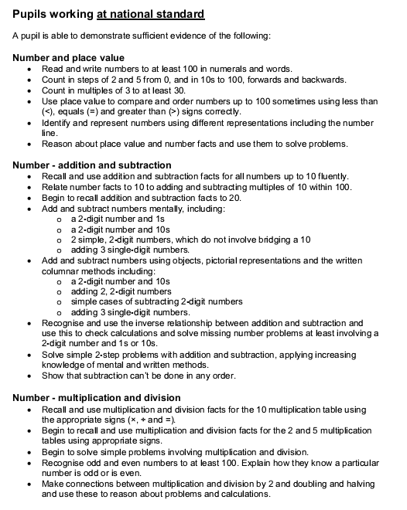
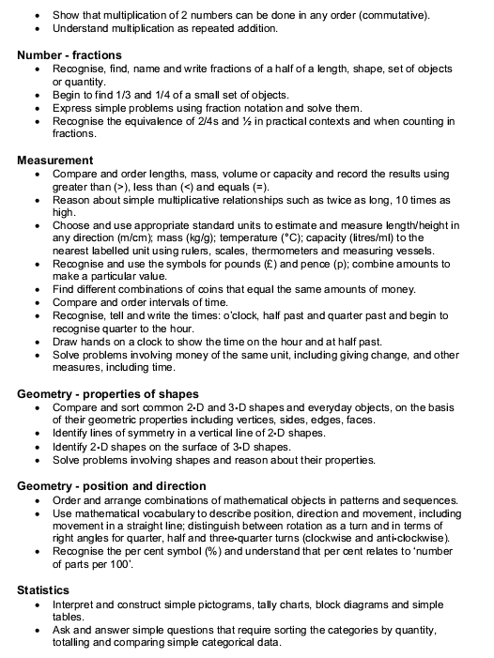
Performance Descriptors e.g. KS1 Maths – Pupils working at national standard
Notes:
Options for Maths at KS1 are:
Pupils working below national standard
Pupils working towards national standard
Pupils working at national standard
Pupils working at mastery standard
The consultation says:
Teachers will need to confirm which description most closely matches a pupil’s overall attainment. There are currently no weightings given to any element within the performance descriptors, so pupils must demonstrate the majority of the elements described.
It doesn’t define ‘majority’ – commentators have asked if this means 51%.

Slide 12
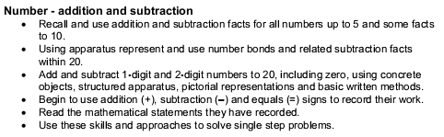
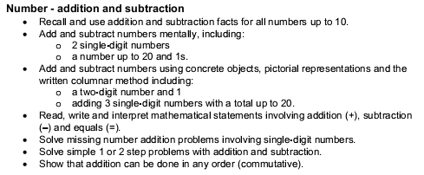
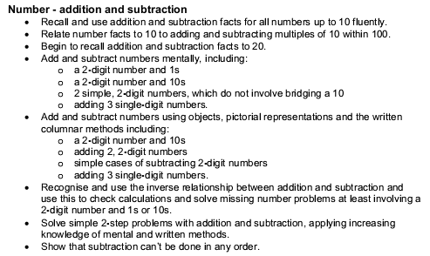
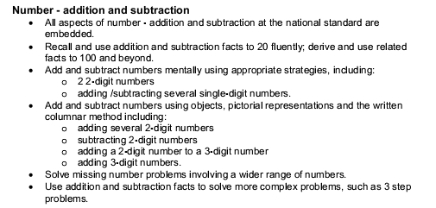
Performance Descriptors e.g. Maths – Number and place value
Working below national standard
Pupils working towards national standard
Pupils working at national standard
Pupils working at mastery standard
Notes:
This slide looks at a small aspect of the Key Stage 1 Maths performance descriptors.
Note that this shows an increase in the number of objectives up to the ‘national standard’ descriptor, whilst the ‘mastery standard’ descriptor is slightly shorter but includes the point ‘All aspects of number – addition and subtraction at the national standard are embedded’.
This ‘embedded’ part is typical of many aspects of the Mastery standard.

Slide 13
All schools have been allowed to create their own assessment systems based around these end of Key Stage expectations.
We wanted to ensure that we could moderate with other local schools to ensure consistency.
We have, therefore, adopted a system created by Hampshire.

Slide 14
English and Maths assessment
Children will be assessed at each milestone as to whether they are at
age related expectations (ARE)
READING: Supporting fluency, clarity, accuracy, and coherence
Comp: Clarify | Comp: Monitor and summarise | Comp: Select and retrieve | Comp:Reason and explain | Themes and conventions | Inference | Language for effect | NOTES FOR ACTION
WRITING: Fluency, clarity, accuracy, coherence
Transcription | Handwriting | Composition | Vocab, Gram, Punctuation | NOTES FOR ACTION
MATHS: Solving problems & working across domains using:
Number and Place value | Addition and subtraction | Multiplication and division | Fractions | Measurement | Geometry | NOTES FOR ACTION
Beyond
Secure
Close to
No (not yet)

Slide 15
English & Maths Assessment example

Slide 16
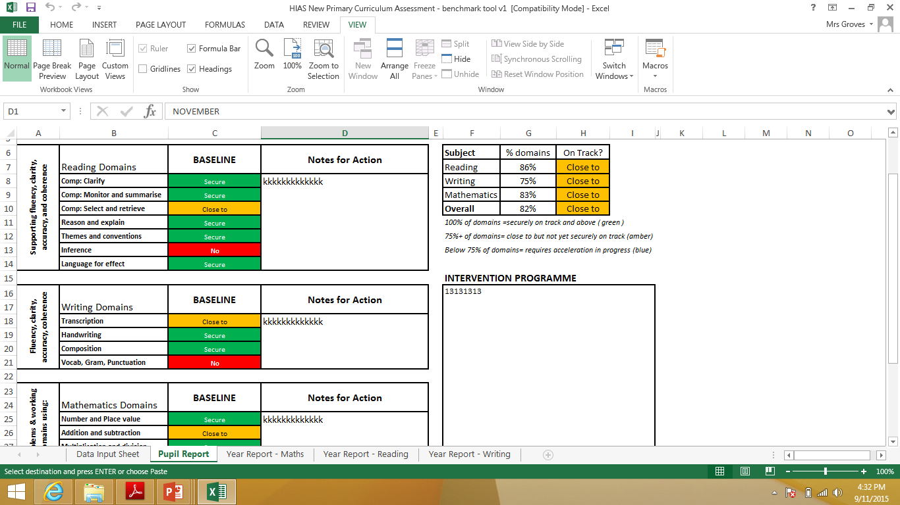

Slide 17
Foundation subjects
Y1-Y6 foundation subject assessment

Slide 18
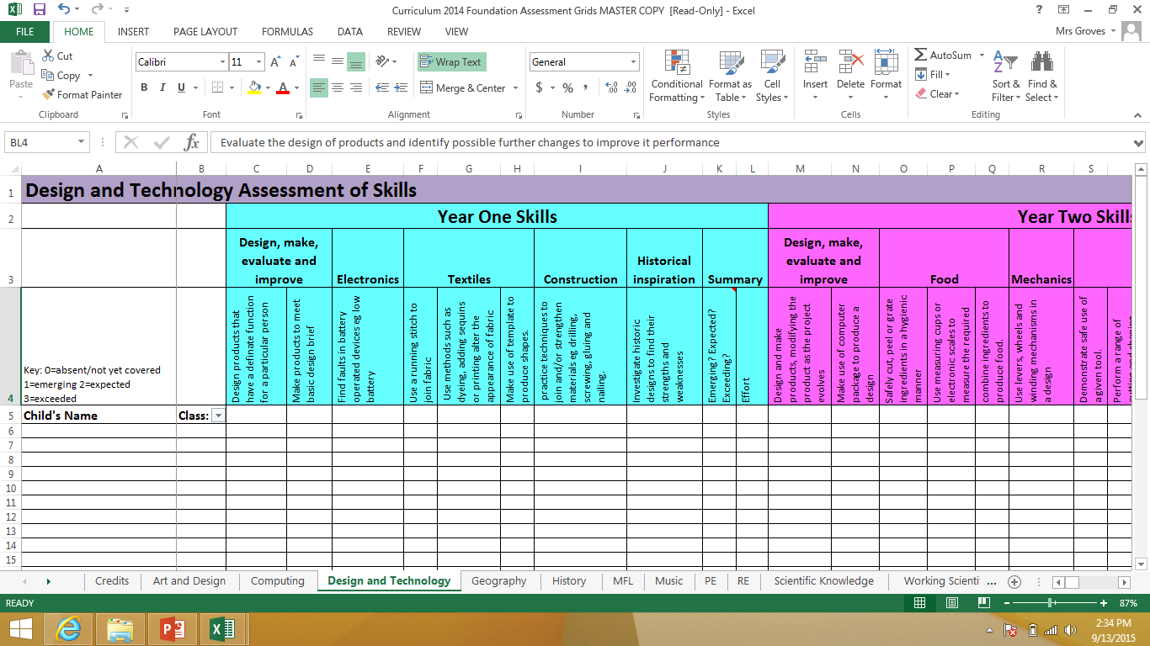

Slide 19
Please remember this is all a new system that we will need to tweak along the way.
We are part of a project group within Hampshire to moderate the system across the year.
We will welcome feedback.

